Slide 1

WattWell
Requirements and concept design
Fairflow Energy
Stevie Wray
stevie@fairflowenergy.com

Slide 2
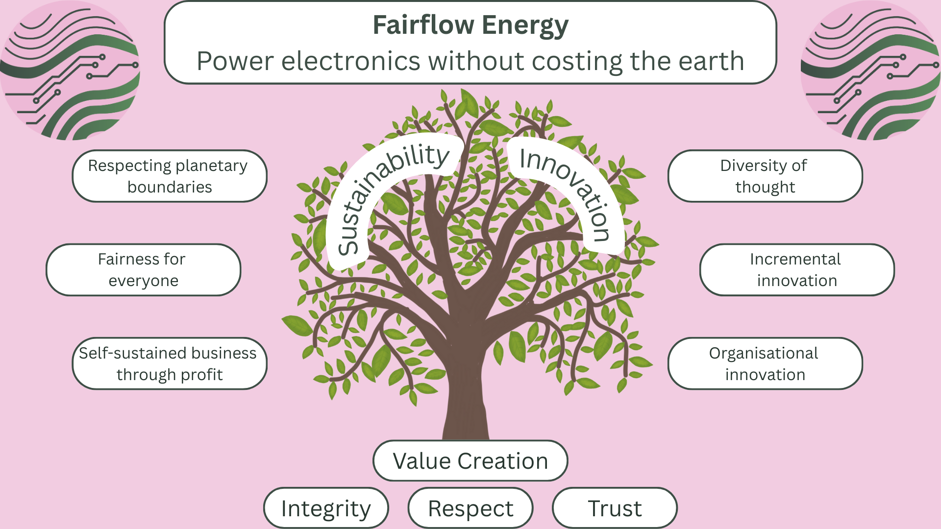

Slide 3

Stevie Wray
The sustainable engineer
Power electronics engineer with a passion for sustainability.
Worked in a startup environment leading power electronics technology development.
Worked in the fusion industry leading the design of the power infrastructure.
Initial experience grounded in the operations and maintenance of complex, high power systems for the Joint European Torus (JET) fusion experiment.
Chartered engineer with experience building teams.
On a journey of discovery about how sustainability can be quantified and practically improved.

Slide 4
Define the system
WattWell - An inverter, built for a lifetime.
A home inverter, to interface battery systems and PV systems with the UK and EU electricity grids.
The WattWell must be:
Durable
Repairable
Open-Source

Slide 5
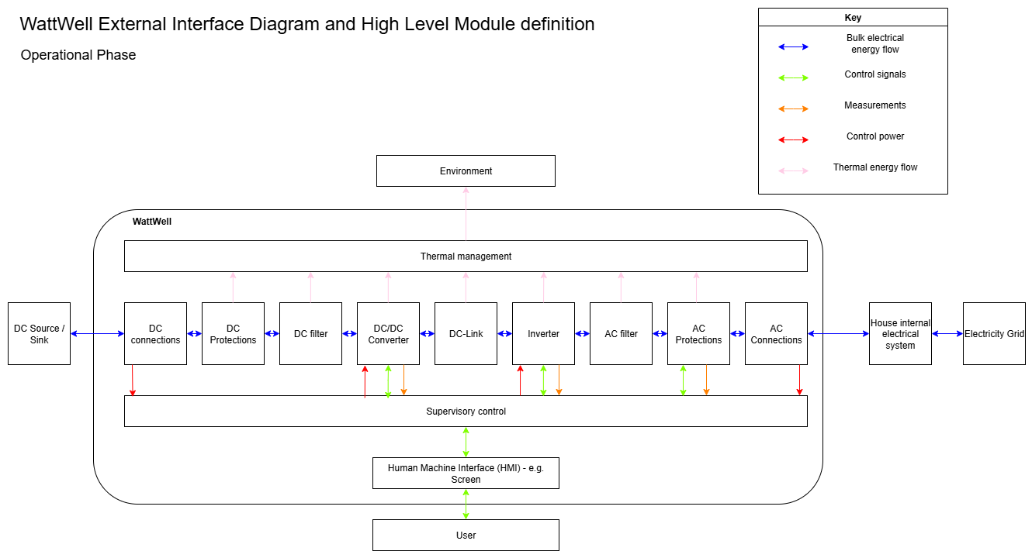

Slide 6
Ideal customer profile
A “solar as a service” provider. Responsible for through life maintenance.
Able to buy WattWells via individual customer orders
Their interests are aligned with selling as many systems as possible, as well as being able to maintain the systems at low cost. Repair and re-use are essential.
They are regularly buying inverter systems.
Likely to be a relatively small company, maybe 10-50 people, with big buying power via their customers.
UK, Belgium or Germany!

Slide 7
The WattWell ecosystem
A manufacture, re-use, refurbish, repair and re-manufacturing ecosystem should be established for the WattWell. This is essential in meeting the vision of an inverter built for a lifetime.
Subsequently compatibility could be added for third party switch modules, done in partnership with manufacturers. E.g. A manufacturer could send their end of life inverters to WattWell manufacturers for remanufacturing into WattWells; claiming responsible disposal. The WattWell team would need to work with the third party to make a process for re-manufacturing without infringing on their IP.

Slide 8
Design principles
Simpler is better - for repair and long term durability. This puts efficiency as a lower priority.
Test-ability and safety during testing are a priority.
Design for attachment and trust is about creating products that will be loved, liked or trusted longer.
Design for durability is about developing products that can take wear and tear.
Design for standardisation and compatibility is aimed at creating products with parts that fit other products as well.
Design for ease of maintenance and repair enables products to be maintained in tip-top condition.
Design for upgradability and adaptability allows for future expansion and modification.
Design for disassembly and reassembly ensures product parts can be separated and reassembled easily.

Slide 9
System Definition
Questions:
AC coupled or DC coupled assets?
  Do we want to interface BOTH PV system and battery with the same WattWell? (DC coupled)
  Or do we want a WattWell per PV system and per Battery? (AC coupled)

Slide 10
Requirements
Comply with the Low Voltage Directive
Comply with the EMC directive
48 V DC bus in (down to 39 V up to 56 V tolerant assuming a Li-Ion 48 V battery's voltage range) to DC side
360 V DC out of DC-DC converter to DC link
Output is 230 V AC +10%, -10% (~207 V AC to 253 V AC) single phase
Bi-directional power flow required - i.e. it could put energy back into a battery system from the grid.
Continuous power levels of ~ 3.6 kW (16 A @ 230 V)
Protection devices in compliance with european and UK grid requirements
“Automatic Grid Protection
Your inverter must have an integrated protection system to automatically and safely disconnect from the grid in the event of a power cut or grid instability. This is crucial to prevent it from energising a "dead" line, which would pose a serious risk to maintenance workers. This includes:
Loss of Mains (LoM) Protection: The inverter must be able to detect when the grid has been de-energised and disconnect itself within 0.5 seconds (UK)
Over and Under Voltage Protection: It must disconnect if the grid voltage goes outside of statutory limits. The standard operating range is typically between 207V and 253V. Must operate in under 200 millisecond (Germany)
Over and Under Frequency Protection: Similarly, it must disconnect if the grid frequency deviates from the standard 50Hz. The typical operating range is between 47Hz and 52Hz.” Must operate in under 200 milliseconds (Germany)
Limited Power Quality Disturbance (THD < 5%?)
No Islanding - option of a manual change-over switch to power household appliances.
Compatible with external export limiters
DC Isolator: A readily accessible DC isolator switch must be installed between the solar panels and the inverter. This allows the high-voltage DC circuit from the panels to be safely disconnected.
AC Isolator: An AC isolator is required to disconnect the inverter from the mains supply, typically located between the inverter and the consumer unit.
Miniature Circuit Breaker (MCB): A dedicated MCB must be installed in your consumer unit for the solar PV system. For a 3.6 kW inverter, a 16A or 20A MCB is commonly used to provide overcurrent protection.
Residual Current Device (RCD): To protect against electric shock from fault currents, a Type A RCD is required for the AC circuit connecting the inverter. Standard Type AC RCDs are not suitable for solar installations as they can be "blinded" by the DC leakage currents that inverters can produce. The RCD should have a 30mA rating.
Surge Protection Devices (SPDs): The latest amendment to BS 7671 makes surge protection a key consideration. SPDs are recommended on both the AC and DC sides of the installation to protect the inverter and other household electronics from voltage spikes, such as those caused by lightning strikes.
Labelling: Clear and durable labelling is required at various points of the installation, including the consumer unit, isolators, and meters, to indicate the presence of a solar PV system.
The inverter must be capable of feeding in reactive power based on the voltage at the connection point (Q(U) control) and must have a reactive power control function that can be adjusted based on active power output (cos φ(P) characteristic curve).
The inverter must operate within a specified voltage and frequency range and disconnect if the values fall outside these limits. For example, in case of an overfrequency event, the inverter must reduce its active power output, typically by 40% per Hz starting at 50.2 Hz, to prevent grid instability.
Harmonics and Flicker:
Safety and Certification: All inverters must be certified and undergo type testing to prove compliance with the VDE-AR-N 4105 standard. This includes checks on their insulation, protective functions, and overall safety.
G99 Compliance: An inverter needs to be tested and certified to comply with G99.
Unity Power Factor: The standard generally mandates that the inverter operates with a power factor between 0.95 lagging and 0.95 leading

Slide 11
Low Voltage Directive
The specific requirements that a home PV inverter must meet under the European Low Voltage Directive (LVD) 2014/35/EU are the Essential Safety Objectives detailed in Annex I of the Directive.
A PV inverter that operates within the LVD's voltage limits (50 to 1,000 V AC or 75 to 1,500 V DC) must be designed and manufactured to satisfy these objectives. Compliance is typically demonstrated by meeting the requirements of relevant harmonized standards, such as the EN 62109 series for PV power converters.
The Essential Safety Objectives are grouped into three main categories:
1. General Conditions
The inverter must ensure safe use through proper design and information:
Identification and Information: The equipment, or an accompanying document, must be marked with the essential characteristics, model, and the manufacturer/responsible person's name and address to ensure it is used safely and for its intended application.
Safe Assembly: The equipment and its components must be constructed to ensure they can be assembled and connected safely and properly.
Maintenance and Intended Use: The inverter must be designed and manufactured to guarantee protection against all hazards when it is used as intended and adequately maintained.
2. Protection Against Hazards Arising from the Electrical Equipment
The design must incorporate measures to protect people, domestic animals, and property from dangers inherent to the equipment:
Protection Against Electric Shock: Measures must be in place to adequately protect persons and domestic animals from physical injury or other harm that might be caused by direct or indirect contact with electrical parts (e.g., proper insulation, earthing/grounding, and enclosures).
Prevention of Dangerous Energy Release: The equipment must be designed not to produce:
  Dangerous temperatures (overheating).
  Arcs (electrical discharge).
  Radiation (that could cause danger).
Non-Electrical Hazards: The design must provide adequate protection against non-electrical dangers (e.g., sharp edges, instability, explosive components) that may be revealed by experience.
Suitable Insulation: The insulation must be appropriate for all foreseeable operating conditions.
3. Protection Against Hazards Caused by External Influences on the Electrical Equipment
The equipment must be robust enough to withstand its expected operating environment without becoming dangerous:
Mechanical Strength: The equipment must meet expected mechanical requirements in such a way that it does not endanger persons, domestic animals, or property (e.g., protection against impacts or vibrations).
Environmental Resistance: It must be resistant to non-mechanical influences in expected environmental conditions (e.g., humidity, ingress of water/dust, corrosion, achieved via an appropriate IP rating for outdoor models).
Overload Safety: The equipment must be designed not to endanger persons, domestic animals, or property under foreseeable conditions of overload (short-circuit or overvoltage).

Slide 12
Protections
Uni-directional:
Input undervoltage
Input overvoltage
Output short-circuit
Output overcurrent
Output overvoltage
Over temperature
For bi-directional, each of these protections should be mirrored when input/output are swapped.

Slide 13
Safety functions
Core functions
Regulatory functions
Aesthetic functions

Slide 14
UK / Germany / Belgium comparisons
Feature | United Kingdom | Germany | Belgium
Key Standard | G98 / G99 | VDE-AR-N 4105 | Regional (e.g., Fluvius, ORES)
"Connect & Notify" | Yes (under 3.68 kW) | No | No
Pre-approval Needed? | Only for systems > 3.68 kW | Always | Always
Process Driver | Inverter Capacity (Amps) | Universal Technical Standard | Regional Grid Operator Rules
Complexity | Low for small systems, moderate for larger ones. | High; technically rigorous and bureaucratic for all sizes. | High; fragmented by region, administrative.
Unique Feature | Clear two-tier system for simple connections. | Strong emphasis on "grid-serving" inverter functions. | Rules vary by region; unique tariff structures (e.g., capacity tariff).

Slide 15
Concept ideas
H bridges everywhere!
Complete one good design of an H bridge, and apply it throughout.
I.e. Dual Active Bridge DC-DC, DC link, then H bridge inverter.
Use personal computer parts / sizes
The case could be an old PC case
The main board could be a motherboard dimensions
The heatsink could be a CPU heatsink
Control board on the PCI-E / GPU?
Distributed control:
Supervisory control sends references to dedicated PWM generators. Supervisor needs all the ADCs; PWM generators need limited sensors to protect and perform main functions.
  Protection functions are delegated to the lowest possible level. Lowest number of obstacles! E.g. shoot-through timing and short circuit detection.

Slide 16
Initial testing
Resistive loads:
DC-DC converter doing the “waveform generation” and inverter just to change polarity. ~77% efficiency.
DC-DC converter powering a DC link (360 V), inverter generating output waveform. ~99.4% efficiency with 1000 Ohm, 97% with 100 Ohm resistor.

Slide 17
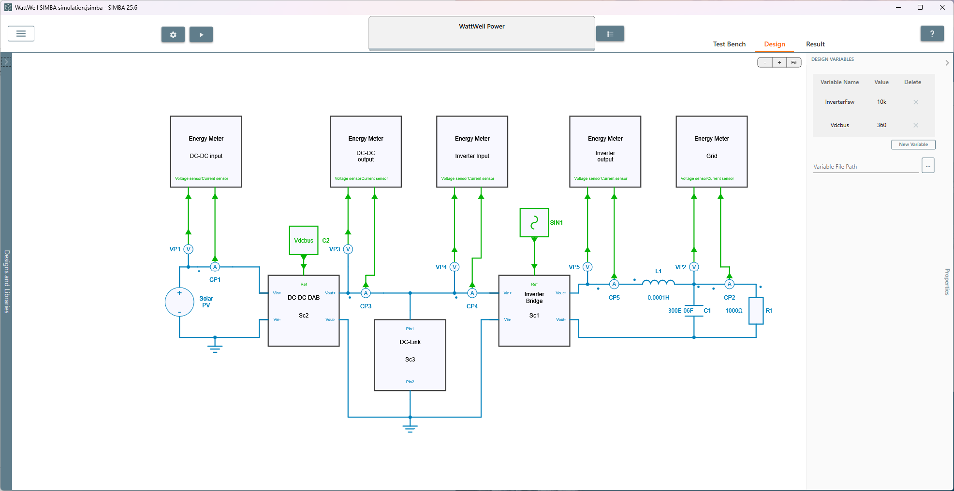

Slide 18
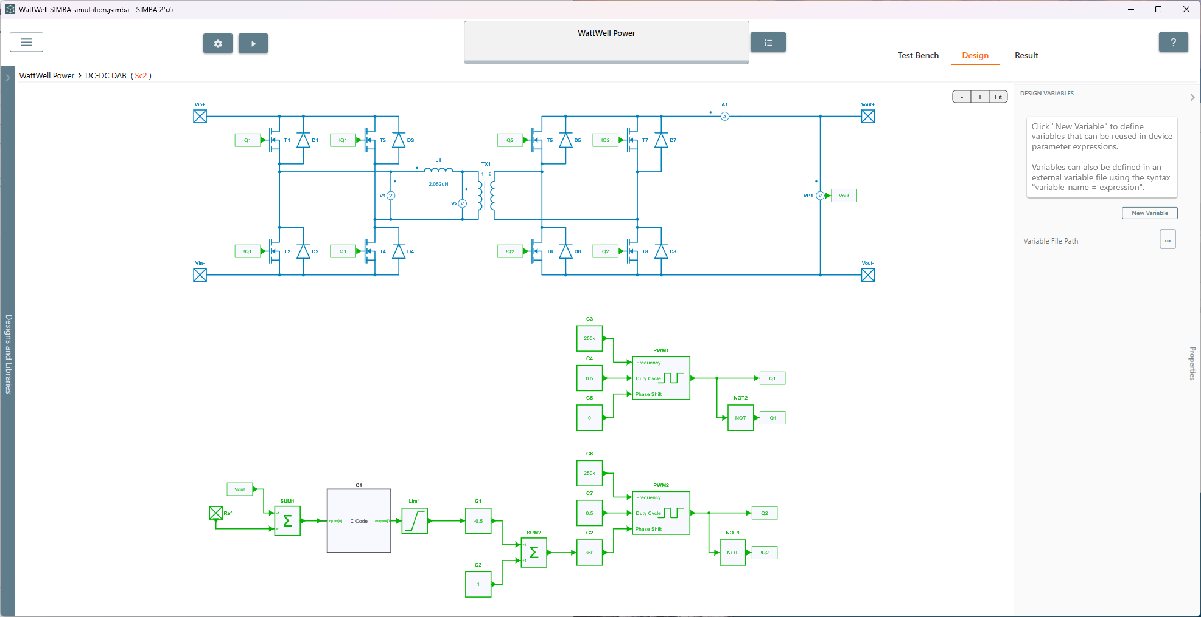

Slide 19
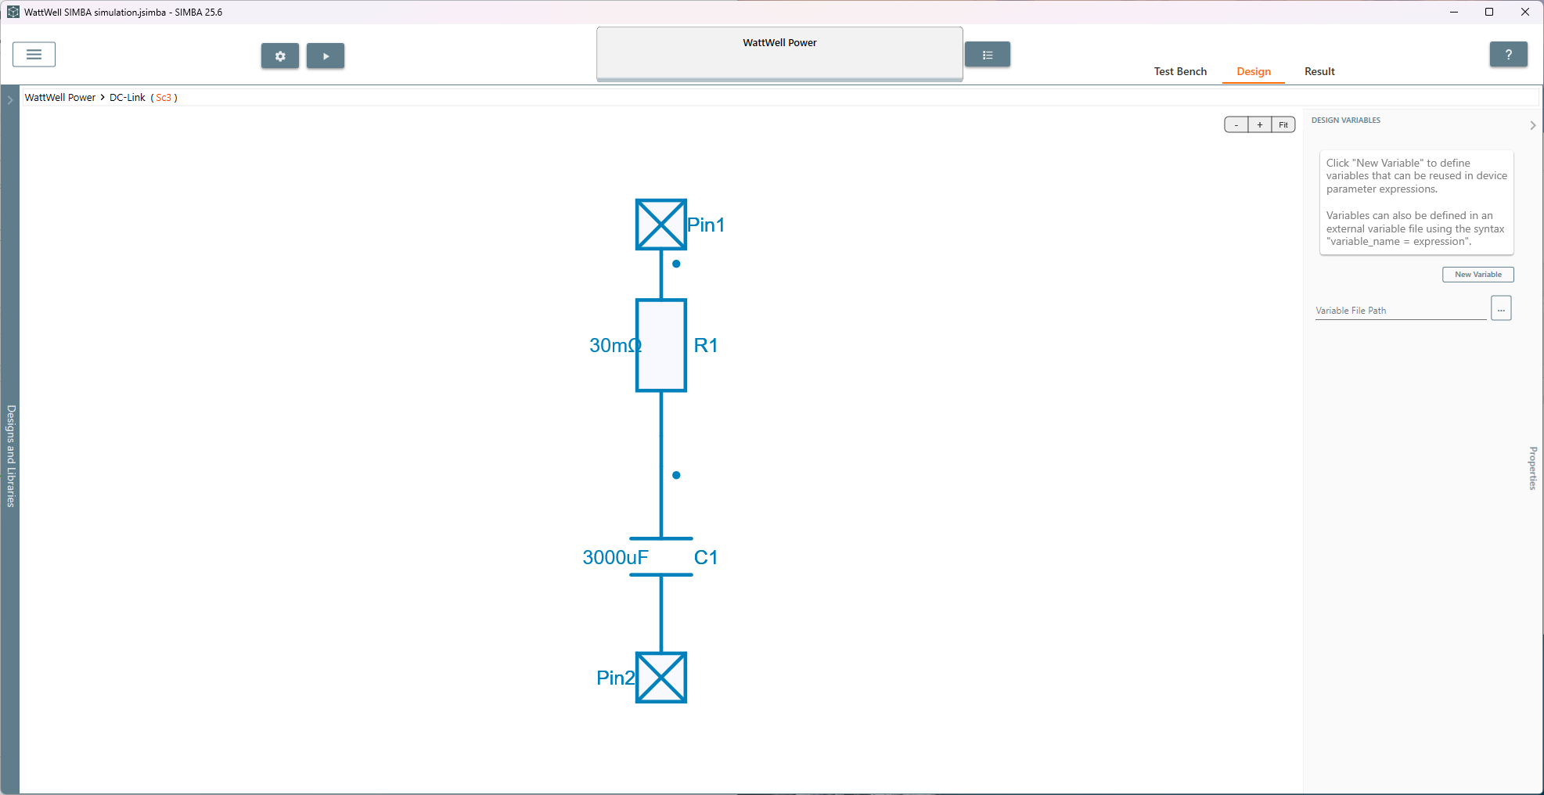

Slide 20
